Slide 1
GANs
Anshu Pandey

Slide 2
Wasserstein GANs
Anshu Pandey

Slide 3
Issues with DCGANs
Generative Adversarial Networks, or GANs, are challenging to train.
The discriminator model must classify a given input image as real (from the dataset) or fake (generated), and the generator model must generate new and plausible images.

Slide 4
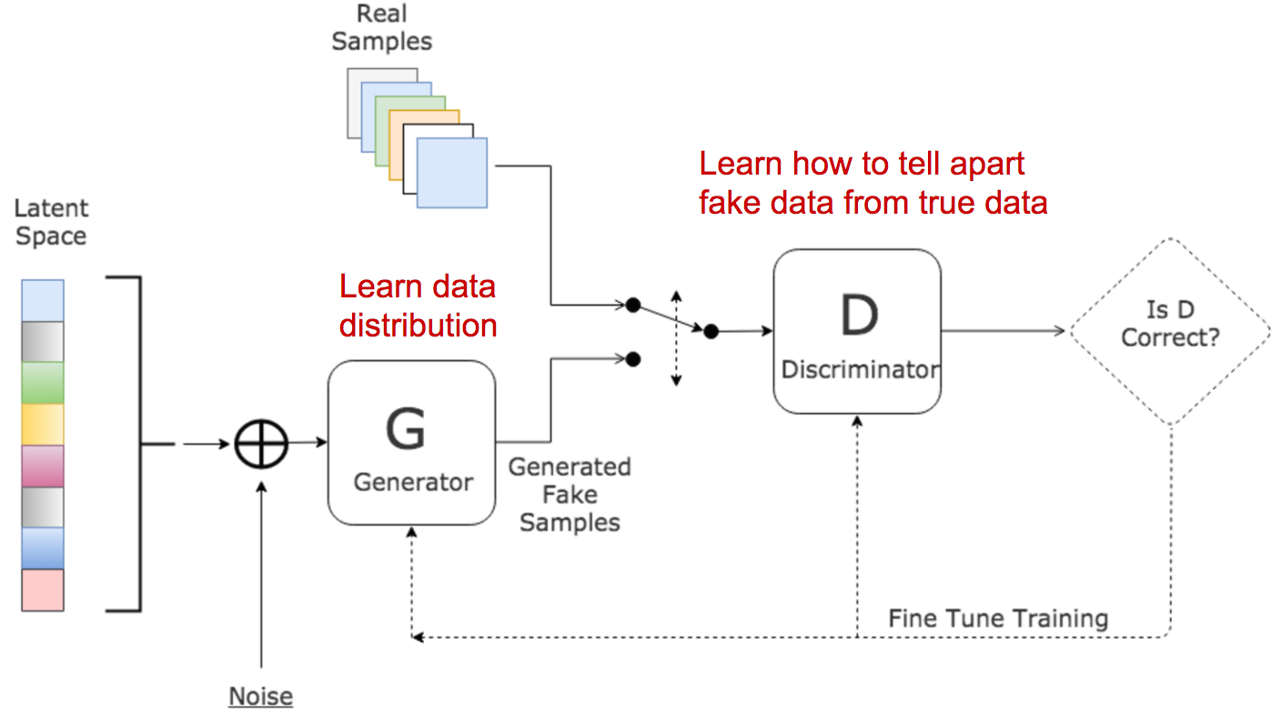
What Is a Wasserstein GAN?

Slide 5
Implementation
Use a linear activation function in the output layer of the critic model (instead of sigmoid).
Use Wasserstein loss to train the critic and generator models that promote larger difference between scores for real and generated images.
Constrain critic model weights to a limited range after each mini batch update (e.g. [-0.01,0.01]).

Slide 6
Implementation
Update the critic model more times than the generator each iteration (e.g. 5).
Use the RMSProp version of gradient descent with small learning rate and no momentum (e.g. 0.00005).

Slide 7
Wasserstein Loss
Critic Loss = [average critic score on real images] – [average critic score on fake images]
Generator Loss = -[average critic score on fake images]

Slide 8
Cycle GANs
Anshu Pandey

Slide 9
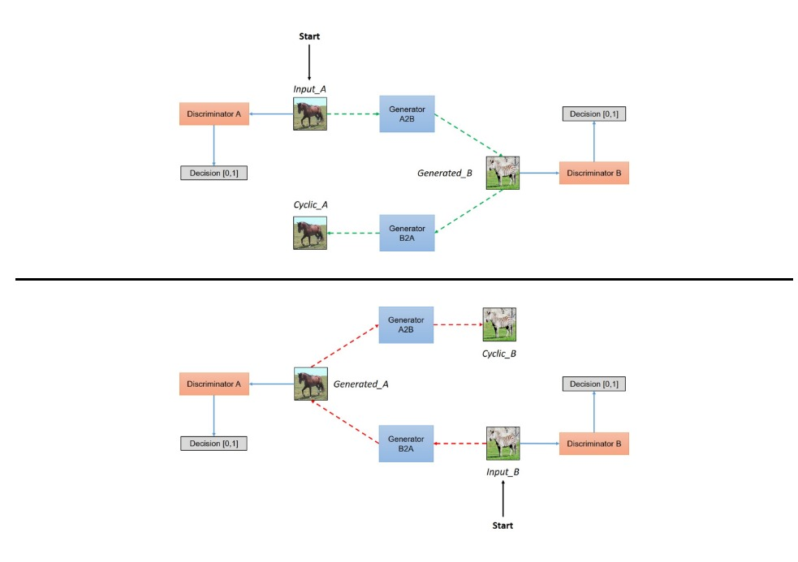
Cycle GANs

Slide 10
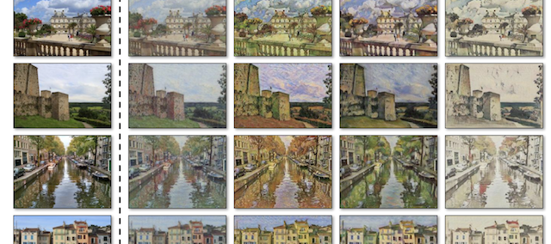
Cycle GANs Applications - Style Transfer

Slide 11
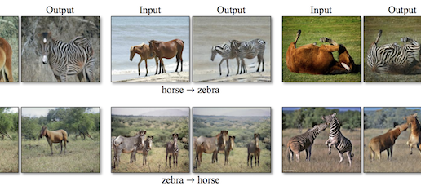
Object Transfiguration

Slide 12
Progressive GANs
Anshu Pandey

Slide 13
Why PGGANs
GANs are effective at generating sharp images, although they are limited to small image sizes because of model stability.
Progressive growing GAN is a stable approach to training GAN models to generate large high-quality images that involves incrementally increasing the size of the model during training.
Progressive growing GAN models are capable of generating photorealistic synthetic faces and objects at high resolution that are remarkably realistic.

Slide 14
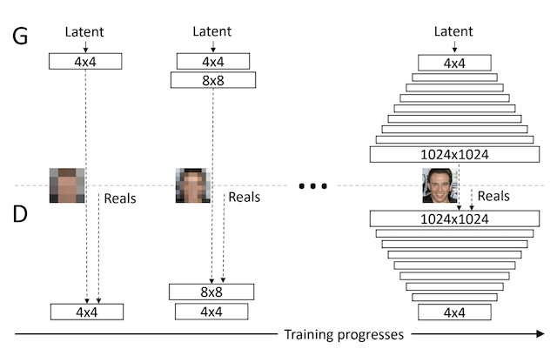
Progressive GANs

Slide 15
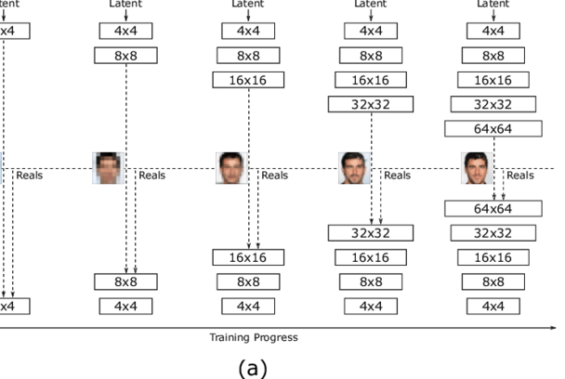
Progressive GANs

